Slide 1
Lecture 1 Introduction To Software Engineering
Maheen Gul
maheen.gul@comsats.edu.pk

Slide 2


Welcome

Slide 3
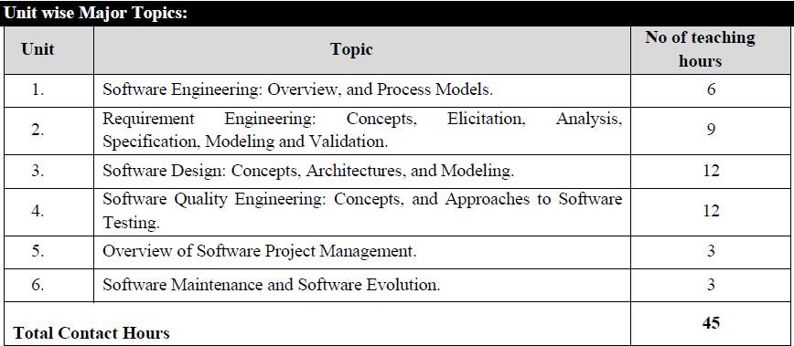
Course Outline

Slide 4
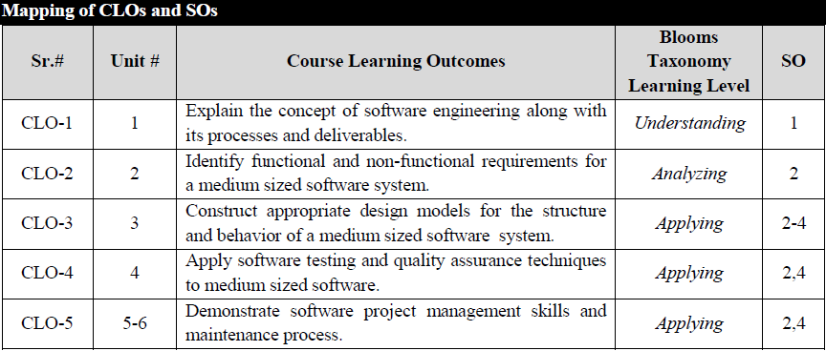
Course Learning Outcomes

Slide 5
Textbooks:
1. Software Engineering: A Practitioner’s Approach, Roger S. Pressman & Bruce R. Maxim, McGraw-Hill, 2020.
2. Engineering Software Products: An Introduction to Modern Software Engineering, Ian Sommerville, Pearson Education Limited, 2021.
Reference Books:
1. Software Engineering, Ian Sommerville, Pearson Education Limited, 2016.
2. Software Engineering with UML, Bhuyan Unhelkar, CRC Press, 2018.

Slide 6
Today’s Overview
1
Software
2
Nature of Software
3
Types of Software
4
Software Products
5
Product Specification
6
Changing nature of software
7
Software Engineering Definition
8
Software Engineering Practice
Notes:
This is another option for an Overview slide.

Slide 7
Software Engineering
Notes:
Use a section header for each of the topics, so there is a clear transition to the audience.

Slide 8
Software
Program: The program or code itself is included in the software.
Data: The data on which the program operates is also considered as part of the software.
Documentation: Another very important thing that most of us forget is documentation. All the documents related to the software are also considered as part of the software.
So the software is not just the code written in different programing languages. It also includes the data and all the documentation related to the program.

Slide 9
The Nature of Software
Software has dual Nature
It is a product
Either running on any machine, It is producing, managing, acquiring, modifying, displaying and transmitting information
Vehicle for delivering a product
OS, Networks, Software Tools and Environment
Significant changes in software has seen as hardware changed
Has become the software industry
Having teams of software specialist producing complex software system
Replace lone programmer of an earlier era

Slide 10
The Nature of Software
But interestingly, the questions that were asked of lone programmer are same as new
Why does it take so long to get software ﬁnished?
Why are development costs so high?
Why can’t we ﬁnd all errors before we give the software to our customers?
Why do we spend so much time and effort maintaining existing programs?
Why do we continue to have difﬁculty in measuring progress as software is being developed and maintained?

Slide 11
Defining Software
Software is:
(1) instructions (computer programs) that when executed provide desired features, function, and performance;
(2) data structures that enable the programs to adequately manipulate information, and
(3) descriptive information in both hard copy and virtual forms that describes the operation and use of the programs.

Slide 12
Software Products
Generic Products
Stand-alone systems that are marketed and sold to any customer who wishes to buy them.
Examples – PC software such as graphics programs, project management tools; CAD software;
Customized Products
Software that is commissioned by a specific customer to meet their own needs.
Examples – embedded control systems, air traffic control software, traffic monitoring systems.

Slide 13
Product Specification
Generic products
The specification of what the software should do is owned by the software developer and decisions on software change are made by the developer.
Customized products
The specification of what the software should do is owned by the customer for the software and they make decisions on software changes that are required.

Slide 14
Software Applications
System software
a collection of programs written to service other programs.
Application software
stand-alone programs that solve a specific business need.
Engineering/scientific software
a broad array of “number-crunching “ programs that range from computer-aided design to molecular biology, from genetic analysis to meteorology.
Embedded software
resides within a product or system and is used to implement and control features and functions for the end user and for the system itself.
WebApps (Web applications)
this network-centric software category spans a wide array of applications and encompasses both browser-based apps and software that resides on mobile devices.
AI software
makes use of nonnumerical algorithms to solve complex problems that are not amenable to computation or straightforward analysis.

Slide 15
Changing nature of Software
Four broad categories of software are evolving to dominate the industry
WebApps
Mobile Applications
Cloud Computing
Product Line Software

Slide 16
Changing nature of Software
WebApps
Early years websites were more than set of hyperlinks, images and texts
Web base systems and applications (WebApps) are being developed with the enhancement of technology
Mobile Applications
The term app ; a software that has been speciﬁcally designed to reside on a mobile platform (e.g., iOS, Android, or Windows Mobile)
Interoperability with Web-based resources
local processing capabilities
Mobile Webapp Vs Mobile App

Slide 17
Changing nature of Software
Cloud Computing
Cloud computing encompasses an infrastructure or “ecosystem” that enables any user, anywhere, to use a computing device to share computing resources on a broad scale

Slide 18
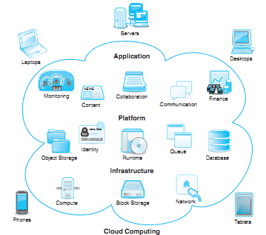
Cloud Computing

Slide 19
Changing nature of Software
Product Line Software
The Software Engineering Institute deﬁnes a software product line as
“A set of software-intensive systems that share a common, managed set of features satisfying the speciﬁc needs of a particular market segment or mission and that are developed from a common set of core assets in a prescribed way”.
A line of software products,
All developed using the same underlying application and data architectures,
All implemented using a set of reusable software components that can be reused across the product line provides signiﬁcant engineering leverage

Slide 20
Cont…
a software product line creates different software versions using common code but with some variations.
Example: Microsoft Office Suite
Microsoft Office has different versions: ✅ Microsoft Word (for writing) ✅ Microsoft Excel (for spreadsheets) ✅ Microsoft PowerPoint (for presentations)
🔹 Common Features: Same interface, toolbar, file format. 🔹 Different Features: Excel has formulas, Word has text editing, PowerPoint has slides.

Slide 21
Cont…
🔹 Why Use Product Line Software?
✅ Saves time & cost (Reuse common components). ✅ Faster development (No need to build from scratch). ✅ Customizable (Easily modify features for different users).

Slide 22
Software Engineering
“Software engineering is an engineering discipline
that is concerned with all aspects of software production”.
Engineering discipline
Using appropriate theories, methods and tools to solve problems bearing in mind organizational and financial constraints.
All aspects of software production
Not just technical process of development. Also project management and the development of tools, methods etc. to support software production.

Slide 23
Importance of Software Engineering
More and more, individuals and society rely on advanced software systems. We need to be able to produce reliable and trustworthy systems economically and quickly.
It is usually cheaper, in the long run, to use software engineering methods and techniques for software systems rather than just write the programs as if it was a personal programming project. For most types of systems, the majority of costs are the costs of changing the software after it has gone into use.

Slide 24
Software Process
Software specification:
Where customers and engineers define the software that is to be produced and the constraints on its operation.
Software development:
Where the software is designed and programmed.
Software validation:
Where the software is checked to ensure that it is what the customer requires.
Software evolution:
Where the software is modified to reflect changing customer and market requirements.

Slide 25
The software process (Simplified)
Feasibility and
Planning
Requirements
Design Implementation
Operation and Maintenance

Slide 26
Software Engineering Practices
Understand the problem (communication and analysis).
Plan a solution(modeling and software design).
Carry out the plan (code generation).
Examine the result for accuracy (testing and quality assurance).

Slide 27
Software Engineering Practices
Understand the problem
Who has a stake in the solution to the problem?
That is, who are the stakeholders?
What are the unknowns?
What data, functions, and features are required to properly solve the problem?
Can the problem be compartmentalized?
Is it possible to represent smaller problems that may be easier to understand?
Can the problem be represented graphically?
Can an analysis model be created?

Slide 28
Software Engineering Practices
Plan a solution
Have you seen similar problems before?
Are there patterns that are recognizable in a potential solution? Is there existing software that implements the data, functions, and features that are required?
Has a similar problem been solved?
If so, are elements of the solution reusable?
Can sub-problems be deﬁned?
If so, are solutions readily apparent for the sub-problems?
Can you represent a solution in a manner that leads to effective implementation?
Can a design model be created?

Slide 29
Software Engineering Practices
Carry out the plan
Does the solution conform to the plan?
Is source code traceable to the design model?
Is each component part of the solution provably correct?
Has the design and code been reviewed, or better, have correctness proofs been applied to the algorithm?

Slide 30
Software Engineering Practices
Examine the result
Is it possible to test each component part of the solution?
Has a reasonable testing strategy been implemented?
Does the solution produce results that conform to the data, functions, and features that are required?
Has the software been validated against all stakeholder requirements?

Slide 31
Stakeholders in software engineering
A stakeholder is anyone who has a stake in the positive or negative outcome of the project
Users
Customers
Software developers
Development managers
Competitors

Slide 32
Questions | Answers
What is software? | Computer programs and associated documentation. Software products may be developed for a particular customer or may be developed for a general market.
What are the attributes of good software? | Good software should deliver the required functionality and performance to the user and should be maintainable, dependable, and usable.
What is software engineering? | Software engineering is an engineering discipline that is concerned with all aspects of software production.
What are the fundamental software engineering activities? | Software specification, software development, software validation, and software evolution.
What is the difference between software engineering and computer science? | Computer science focuses on theory and fundamentals; software engineering is concerned with the practicalities of developing and delivering useful software.

Slide 33
Questions | Answers
What is the difference between software engineering and system engineering? | System engineering is concerned with all aspects of computer-based systems development including hardware, software, and process engineering. Software engineering is part of this more general process.
What are the key challenges facing software engineering? | Coping with increasing diversity, demands for reduced delivery times, and developing trustworthy software.
What are the costs of software engineering? | Roughly 60% of software costs are development costs; 40% are testing costs. For custom software, evolution costs often exceed development costs
What are the best software engineering techniques and methods? | While all software projects have to be professionally managed and developed, different techniques are appropriate for different types of system. For example, games should always be developed using a series of prototypes whereas safety critical control systems require a complete and analyzable specification to be developed. You can’t, therefore, say that one method is better than another.

Slide 34
Questions | Answers
What differences has the Web made to software engineering? | The Web has led to the availability of software services and the possibility of developing highly distributed service-based systems. Web-based systems development has led to important advances in programming languages and software reuse.

Slide 35
Attributes of Software
Product characteristics | Description
Maintainability | Software should be written in such a way so that it can evolve to meet the changing needs of customers. This is a critical attribute because software change is an inevitable requirement of a changing business environment.
Dependability and security | Software dependability includes a range of characteristics including reliability, security, and safety. Dependable software should not cause physical or economic damage in the event of system failure. Malicious users should not be able to access or damage the system.
Efficiency | Software should not make wasteful use of system resources such as memory and processor cycles. Efficiency therefore includes responsiveness, processing time, memory utilization, etc.
Acceptability | Software must be acceptable to the type of users for which it is designed. This means that it must be understandable, usable, and compatible with other systems that they use.

Slide 36
Thank You

